Slide 1
Securing Spring Boot Applications with JWT
JSON Web Token (JWT) Authentication

Slide 2
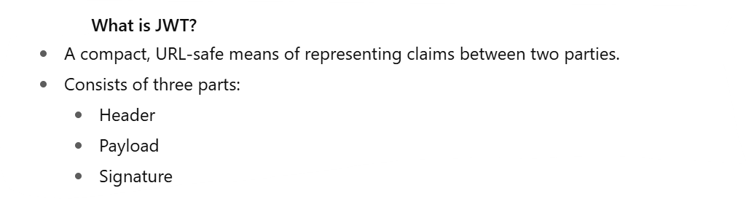

Slide 3
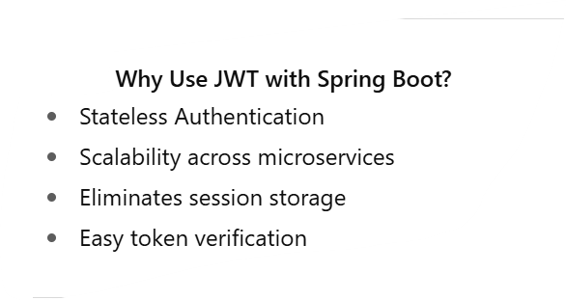

Slide 4
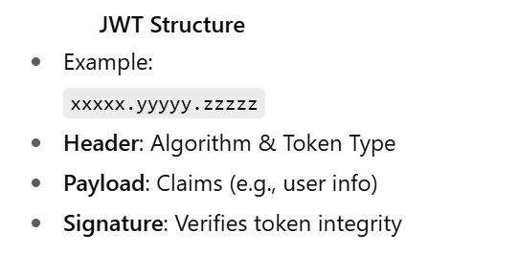

Slide 5
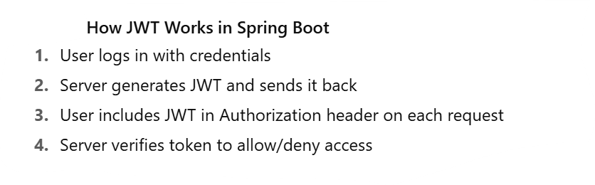

Slide 6
Basic Flow Diagram
simple 4-step flow: Client → Login → JWT → Authorized Requests

Slide 7
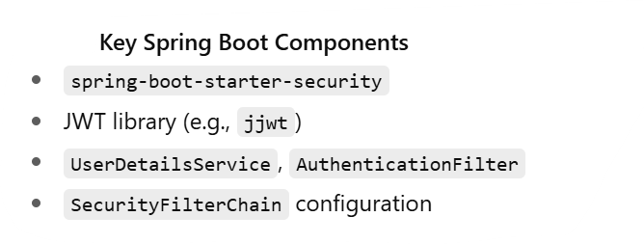

Slide 8
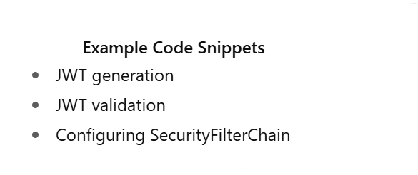

Slide 9
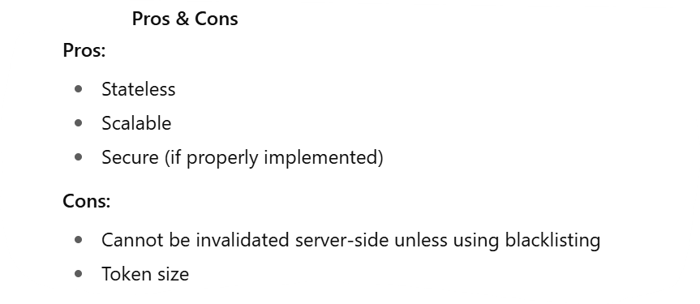

Slide 10
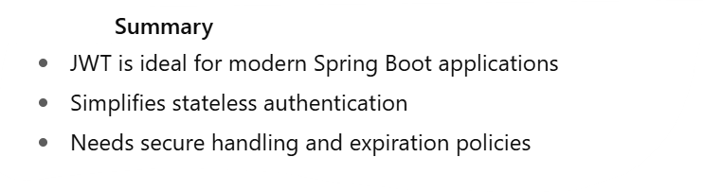

Slide 11
Demo TIme
C:\AWS-DevOPS\VP\All Courses\Microservices - Cloud Native\Demos\07-spring-boot-3-jwt-security

